Slide 1
Movie Recommendation WebApp using Content based Recommendation System
Pranay Gore_24
Rahul Shah_34
Lokesh Sharma_35

Slide 2
INTRODUCTION
In the digital age of endless entertainment choices, movie recommendation systems have become an essential tool for helping users discover films that align with their tastes and preferences. Content-Based Filtering is one of the fundamental approaches to movie recommendation, offering a personalized movie selection process that relies on the intrinsic characteristics of movies and the user's historical preferences.

Slide 3
Problem Statement
The problem at hand is the overwhelming diversity of movie choices available to consumers, leading to difficulty in finding movies that truly resonate with individual tastes. Existing movie recommendation systems often rely on collaborative filtering, which may not capture the subtleties of a user's preferences accurately. This problem statement seeks to address the need for a robust content-based movie recommendation system that leverages the intrinsic characteristics of movies, such as genres, directors, actors, and plot keywords, to offer personalized recommendations. The challenge lies in developing a system that can efficiently extract and analyze content attributes, providing users with relevant movie suggestions, ultimately enhancing the movie-watching experience and simplifying the movie discovery process..

Slide 4
Objective
The primary scope of the content-based filtering movie recommendation system lies in offering a personalized movie discovery experience for users. This system will focus on the analysis of content attributes, including genres, actors, directors, and plot keywords, to generate movie recommendations. It should provide users with the ability to search for movies by name and offer a diverse set of recommendations based on content features. The scope also encompasses the development of an intuitive user interface that simplifies interactions, allowing users to input their preferences and explore a broad array of movie recommendations.

Slide 5
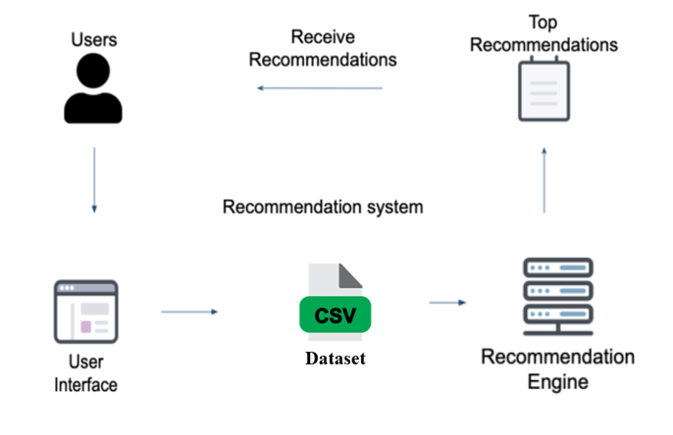
Block Diagram

Slide 6
Thank YOU!!!!

